Slide 1


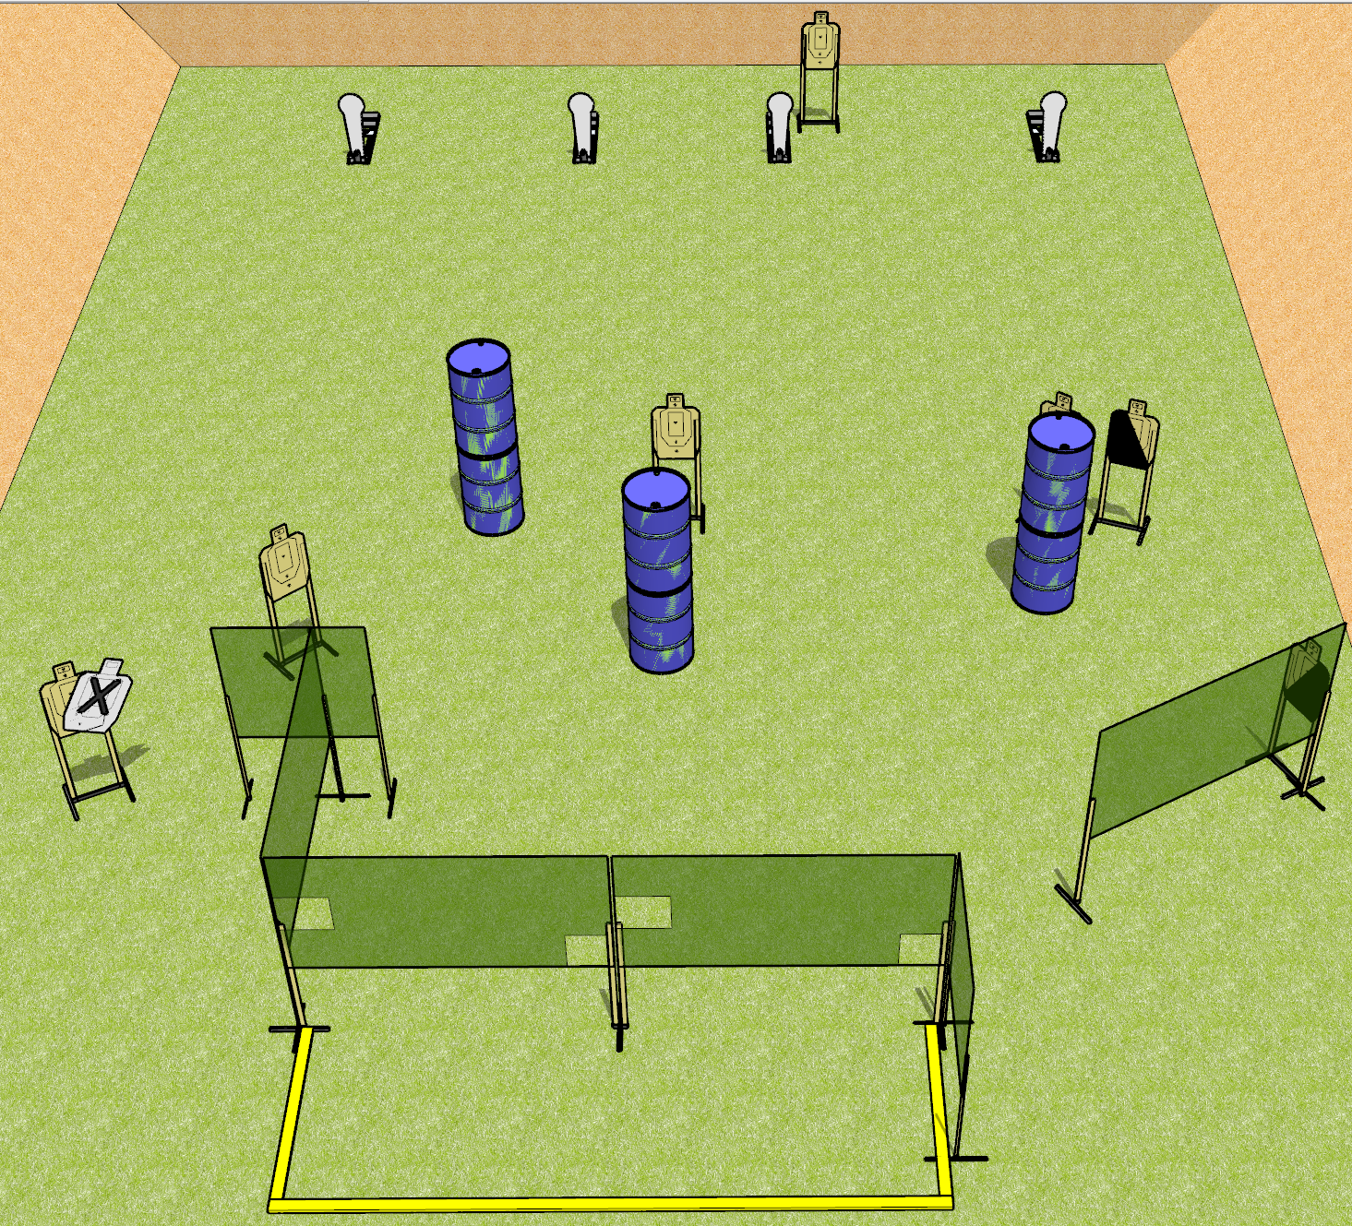
 | Dothan Gun Club – USPSA Match Pecking Order Course Designer : Drew Coleman
Round Count 18 rounds 7 USPSA 4 colt poppers
Equipment List 1 medium fault line 9 wall feet 1 left + 1 right diag 6 targets (5 + 1 NS)

Slide 2
Pecking Order
Written Stage Briefing
Pecking Order is an 18 round, 90 point, Comstock course of fire. There are 7 USPSA targets and 4 colt poppers. The best 2 hits on paper will score.
Handgun start position is completely outside the shooting area, wrists below belt. Handgun is loaded and holstered.
PCC start position is completely outside the shooting area, stock on belt. Loaded carbine is held with both hands, safety on.
On the audible start signal, engage targets as they become available from within the shooting area.

Slide 3
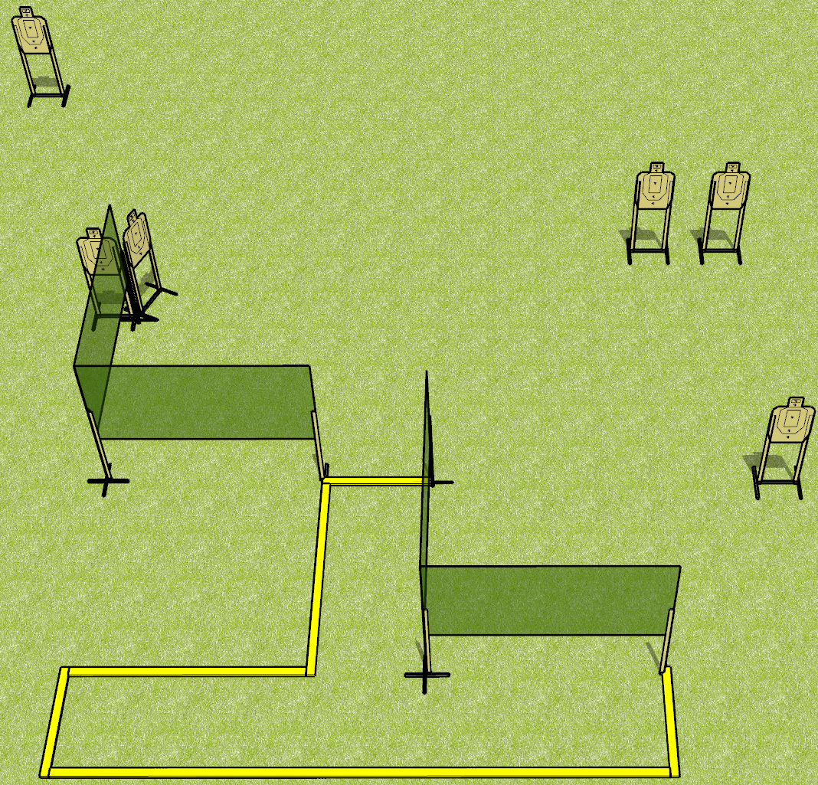
 | Dothan Gun Club – USPSA Match Standard Deviation Course Designer : Drew Coleman
Round Count 24 rounds 6 USPSA targets
Equipment List 3 medium fault lines 6 wall feet

Slide 4
Standard Deviation
Written Stage Briefing
Standard Deviation is a 24 round, 120 point, Virginia count standard exercise. There are 6 USPSA targets. The best 4 hits on paper will score. The start signal is audible.
Handgun is loaded and holstered, wrists below belt.
Loaded carbine is held with both hands, stock on belt, safety on.
Stage Procedure:
String 1: start position is inside shooting area. On start signal, from within the shooting area, engage 3 targets with 2 rounds each, perform a mandatory reload, and engage remaining 3 targets with 2 rounds each Strong Hand Only
String 2: start position is toes against front fault line. On start signal, from within the shooting area, engage 3 targets with 2 rounds each, perform a mandatory reload, and engage remaining 3 targets with 2 rounds each Weak Hand Only

Slide 5
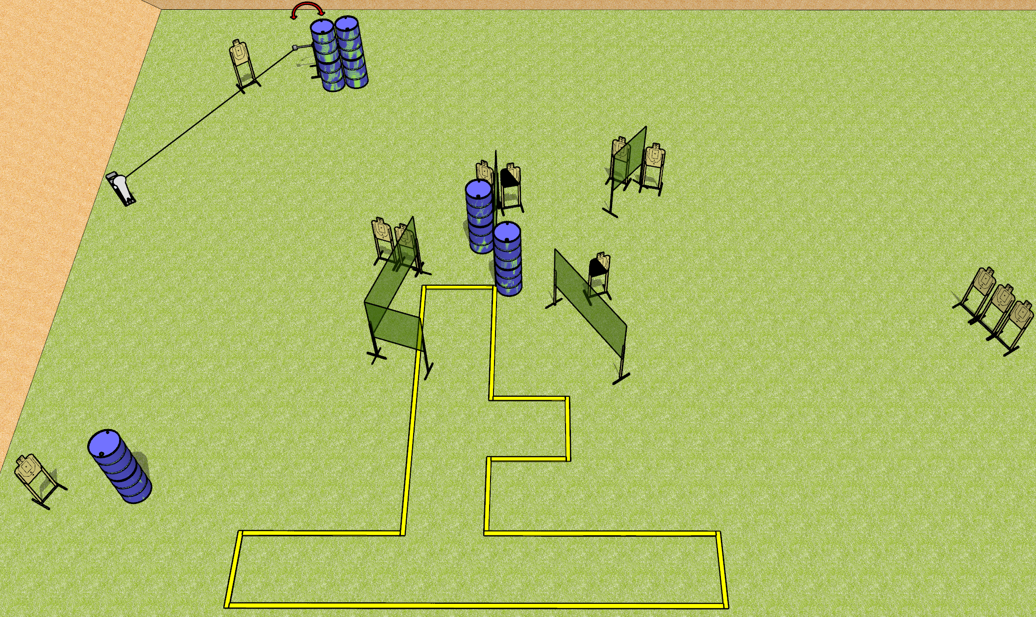
 | Dothan Gun Club – USPSA Match Surprise Course Designer : Drew Coleman
Round Count 27 rounds 13 USPSA 1 Colt popper
Equipment List 6 medium fault lines 9 wall feet 2 left diag 11 targets

Slide 6
Surprise
Written Stage Briefing
Surprise is a 27 round, 135 point, Comstock course of fire. There are 13 USPSA targets and 1 colt popper. The best 2 hits on paper will score, and steel must fall to score.
The swinger is activated by the colt popper and remains visible at rest.
Handgun start position is inside shooting area, wrists below belt. Handgun is loaded and holstered.
PCC start position is inside shooting area, stock on belt. Loaded carbine is held with both hands, safety on.
On the audible start signal, engage targets as they become available from within the shooting area.

Slide 7
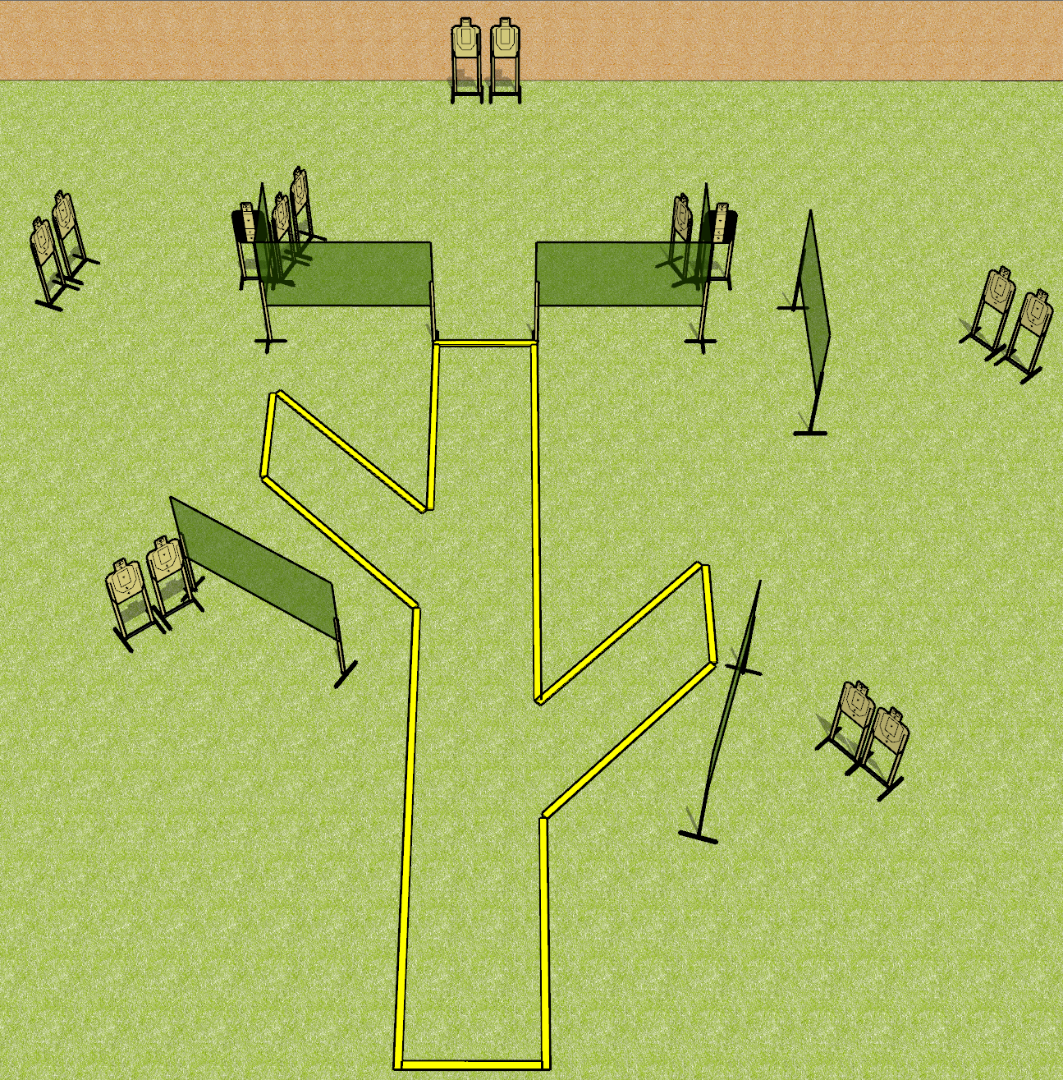
 | Dothan Gun Club – USPSA Match Branching Out Course Designer : Drew Coleman
Round Count 30 rounds 15 USPSA
Equipment List 4 medium fault lines 12 wall feet 2 tux 13 targets

Slide 8
Branching Out
Written Stage Briefing
Branching Out is a 30 round, 150 point, Comstock course of fire. There are 15 USPSA targets. The best 2 hits on paper will score.
Handgun start position is toes touching rear fault line, facing uprange, wrists above shoulders. Handgun is loaded and holstered.
PCC start position is heels touching rear fault line, stock on belt. Loaded carbine is held with both hands, safety on.
On the audible start signal, engage targets as they become available from within the shooting area.

Slide 9
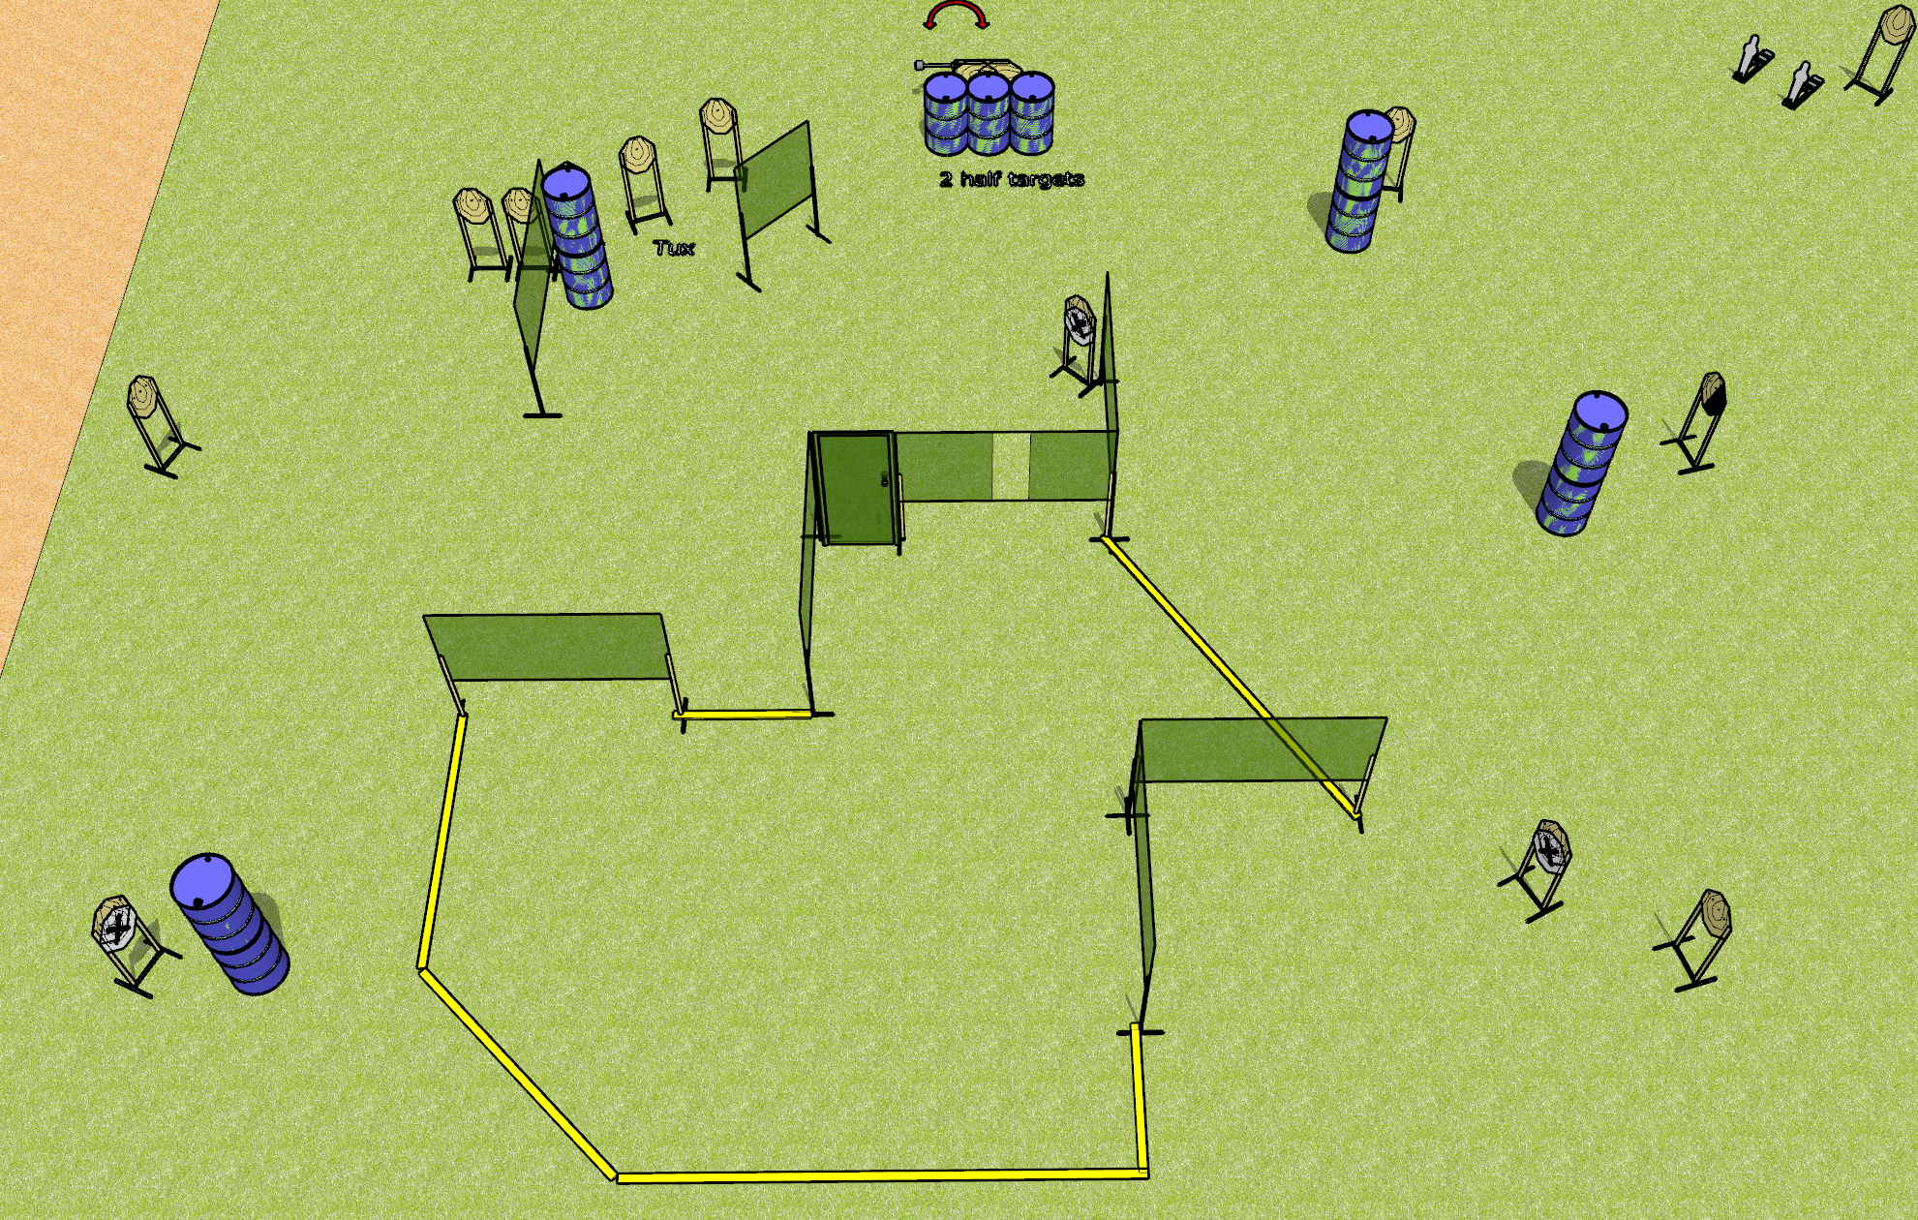
 | Dothan Gun Club – USPSA Match Whole Lotta Nothing Course Designer : Drew Coleman
Round Count 32 rounds 15 IPSC 2 mini poppers
Equipment List 2 medium fault lines 14 wall feet 1 swinger + 1 door + activator 1 tux + 1 right diag + 2 cut in half 14 targets (11 + 3 NS)

Slide 10
Whole Lotta Nothing
Written Stage Briefing
Whole Lotta Nothing is a 32 round, 160 point, Comstock course of fire. There are 15 IPSC targets and 2 mini poppers. The best 2 hits on paper will score and steel must fall to score.
The swinger is activated by the door and remains visible at rest.
Handgun start position is inside shooting area, wrists below belt. Handgun is loaded and holstered.
PCC start position is inside shooting area, stock on belt. Loaded carbine is held with both hands, safety on.
On the audible start signal, engage targets as they become available from within the shooting area.

